Slide 1
Text generation using TensorFlow

Slide 2
1- ai is the new electricity
2 - ai is my power
The next thing to do is to generate a unique token for each of the words. Repeating words in the corpus are assigned the same token. This can be easily done using the Tokenizer in TensorFlow.

Slide 3
For the first sentence:
ai -> 1
is -> 2
the -> 3
new -> 4
electricity -> 5

Slide 4
For the second sentence:
ai -> 1
is -> 2
my -> 6
power -> 7

Slide 5
Now, we may represent our sentences as a list of numbers:
[1, 2, 3, 4, 5] -> For the first sentence
[1, 2, 6, 7] -> For the second sentence

Slide 6
Data preprocessing for squnce
For the first sentence [1, 2, 3, 4, 5]
[1, 2]
[1, 2, 3]
[1, 2, 3, 4]
[1, 2, 3, 4, 5]

Slide 7
For the second sentence [1, 2, 6, 7]
[1, 2]
[1, 2, 6]
[1, 2, 6, 7]

Slide 8
After padding each sequence will look like:
For the first sentence [1, 2, 3, 4, 5]
[0, 0, 0, 1, 2]
[0, 0, 1, 2, 3]
[0, 1, 2, 3, 4]
[1, 2, 3, 4, 5]

Slide 9
For the second sentence [1, 2, 6, 7]
[0, 0, 0, 1, 2]
[0, 0, 1, 2, 6]
[0, 1, 2, 6, 7]

Slide 10
Say the feature is x = [0, 1, 2, 3, 4]
The corresponding label is Label = [5]
So the one-hot encoded vector of the Label is: [0, 0, 0, 0, 1] i.e. there is 1 present in the 5th position of the vector and 0 in the remaining position.
Hence, y = [0, 0, 0, 0, 1]

Slide 11
The first layer is the Embedding Layer which would be the first layer in the network. This layer takes three arguments namely, the input dimension (the total number of unique words in our corpus); the output dimension (or the embedding dimension in which vectors will be mapped); and the input length (the length of each sequence that is fed).
For the second layer, we add a Bidirectional LSTM layer of 20 units which is efficient for taking care of the vanishing gradient problem in long sentences and dependencies.
And consequently, in the third layer, we add a Dense Layer with p units. Where p is the total number of unique words in our corpus and we apply softmax activation to each of these units.

Slide 12
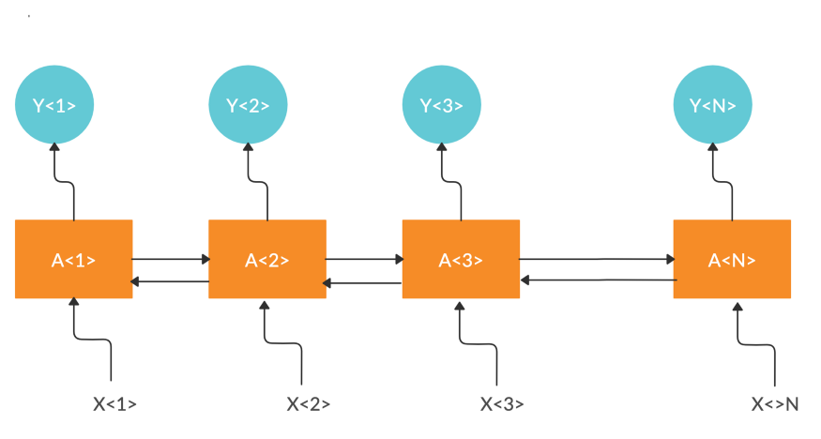

Slide 13
